Slide 1
Surface reconstruction by Voronoi filtering
https://dl.acm.org/doi/10.1145/276884.276889

Slide 2

Background
Mainly heuristic solutions, except …
Hoppe et al.'s algorithm (without guarantee on accuracy and completeness)
α-shape of Edelsbrunner et al. (with guarantee on 2D)
Euclidean minimum spanning tree (with guarantee on 2D)
Crust

Slide 3
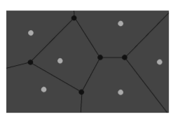
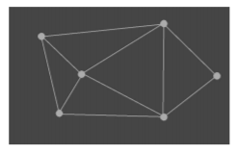
Voronoi Diagram & Delaunay Trianglulation
Points closest to each sample form cells
Delaunay triangles connect adjacent samples

Slide 4
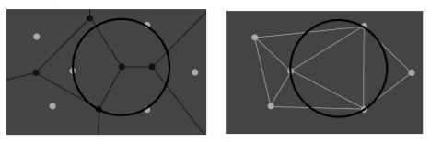
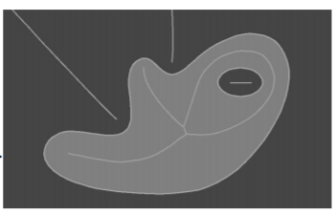
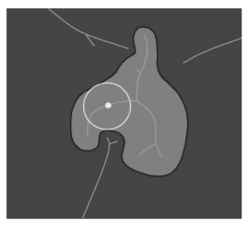
Voronoi balls centered at Voronoi vertices pass through closest samples
Medial axis is set of points with more than one closest sample.
Maximal ball avoiding surface is a medial ball.

Slide 5
CRUST
Related algorithm: Boissonnat’s algorithm
"sculpts" the interior of a geometry with a subset of Delaunay tetrahedral
First observation: Typical Delaunay tetrahedra possesses circumspheres approximating maximal empty balls whose center is at the points of medial axis
False conclusion: not considering dense sample sets being able to give Delaunay tetrahedra with circumspheres that are arbitrarily far from the medial axis
Second observation: Poles

Slide 6
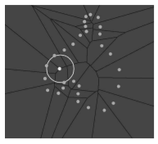
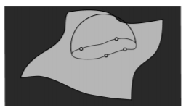
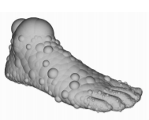
Problems with CRUST in 3D
For 2D, Voronoi balls approximate medial balls
In 3D, some Voronoi vertices are not near medial axis.
Mostly caused by uneven sample distribution

Slide 7
CRUST upgraded
Use Voronoi to approximate the middle axis of sample points S
Filter with poles
Filter with normal
Construct the surface from the middle axis with Delaunay/ filtered Delaunay triangulation.

Slide 8
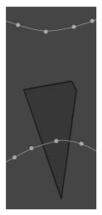
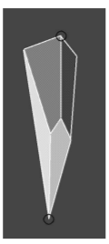
Poles
For dense surface (amount of samples are bigger compared to average), Voronoi cells are:
Long and skinny
Perpendicular to surface
With ends near the medial axis
Therefore the points except the two ends of the “long” direction are noise
Poles: Voronoi vertices at opposite ends

Slide 9
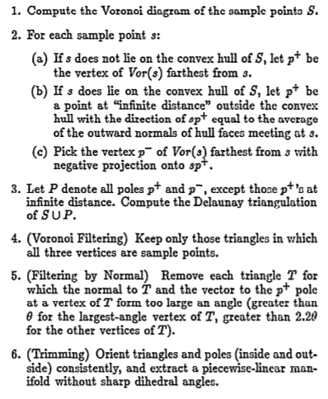
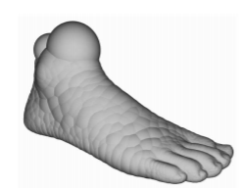
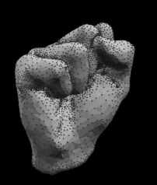

Slide 10
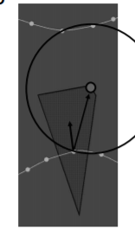
Filter by Normal
The reconstructed surfaces’ normal need to converge to original surfaces’ normal.
Medial ball touching sample s has to be nearly tangent to surface at s

Slide 11
Result
The algorithm is designed for smooth surface reconstruction, and it requires sufficient samples.
On the assumption above, the reconstructed surface is homemorphic to the original surface.
The reconstructed surfaces’ normals converges to original surfaces’ normals

Slide 12
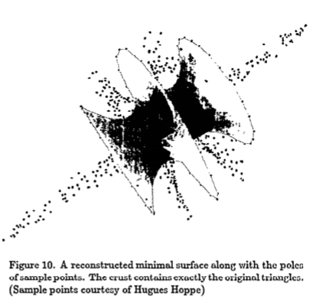
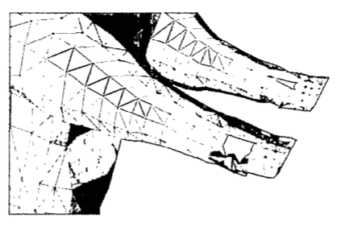
Pros & Cons
Pros
Accurate to obtain smooth surface for most point clouds
Robust in input: Uneven samples (very useful in practical)
Robust in output: Can do closure for open area samples, good at removing extra links.
Cons
Voronoi diagram is costly
Bad performance when sample set is not sufficiently dense
Bad performance at sharp corners

Slide 13
Comparison with other related methods
Euclidean minimum spanning tree & α-shapes
Have guarantee in 2D
But the result depends on sample density, bad at dealing with uneven point clouds.
No guarantees for 3D and higher.
β-skeleton
Have guarantee in 2D
Have guarantee in uneven point clouds.
No guarantees for 3D and higher. (Proved)

Slide 14
Future work
The CRUST algorithm has been proved extendible, the other algorithm has guarantee to uneven sample point clouds, β-skeleton’s extension to higher dimension is worth researching.
The minimal sample amount and the limitation value of θ is still undetermined, it need more experiment data.
The algorithm is oriented to smooth surface, it can still be improved to fit the requirement of sharp surface reconstruction
The cost of algorithm is high, some optimization need to be made.

